Slide 1
File I/O
Notes:
In a real sofware, files are ways to store data of a program. Data in a file can be binary bytes, characters, and even binary data of objects belonging to a specific class. Depending on storing formats, read from and write data to a file are different. So, the java.io package supplies APIs for managing directories and files.

Slide 2
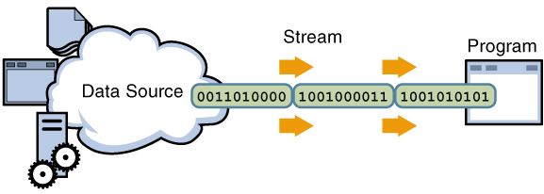
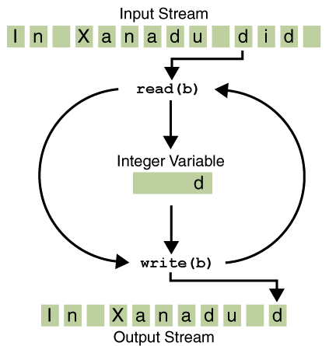
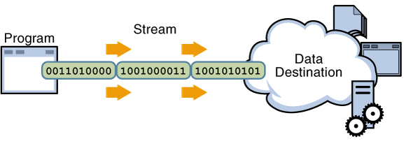
What are streams?
A stream is an object managing a data source in which operations such as read data in the stream to a variable, write values of a variable to the stream associated with type conversions are performed automatically. These operations treat data as a chain of units (byte/character/data object) and data are processed in unit-by-unit manner.
Input stream
Output stream

Slide 3
Why should you study this chapter?
Files can not be missing in large applications.
Do you want to access a file in Java?
How can we read/write data from/to a file?

Slide 4
Objectives
Distinguishing Text, UTF, and Unicode
How to access directories and files?
How to access text files.
How to access binary files?
How to read/write objects from/to files

Slide 5
Contents
Text, UTF, and Unicode
Introduction to the java.io package
Accessing directories and files
Accessing binary files
Accessing text files.
Read/write objects from/to files?

Slide 6
1- Text, UTF, and Unicode
ASCII code
(8 bits)
256 characters
Character
Unicode
(16 bits)
65536 characters
( not completely represented)
Unicode character: a character is coded using 16/32 bits
UTF: Universal Character Set – UCS- Transformation Format
UTF: Unicode transformation format , a Standard for compressing strings of Unicode text .
UTF-8: A standard for compressing Unicode text to 8-bit code units.
Refer to: http://www.unicode.org/versions/Unicode7.0.0/
Java :
Uses UTF to read/write Unicode
Helps converting Unicode to external 8-bit encodings and vice versa.

Slide 7
2- Introduction to the java.io Package
Java treats all data sources ( file, directory, IO devices,…) as streams
The java.io package contains Java APIs for accessing to/from a stream.
A stream can be a binary stream.
Binary low-level stream: data unit is a physical byte.
Binary high-level stream: data unit is primitive data type value or a string.
Object stream: data unit is an object.
A stream can be a character stream in which a data unit is an Unicode character.

Slide 8
3- Accessing directories and files
The java.io.File Class
Class represents a file or a directory managed by operating system.
Java Program
java.io.File class
Constructor Summary
File(File parent, String child) Creates a new File instance from a parent abstract pathname and a child pathname string.
File(String pathname) Creates a new File instance by converting the given pathname string into an abstract pathname.
File(String parent, String child) Creates a new File instance from a parent pathname string and a child pathname string.
File(URI uri) Creates a new File instance by converting the given file: URI into an abstract pathname.
OS
Directories/ Files
Information

Slide 9
Accessing directories and files…
The java.io.File Class…
This class helps accessing file/directory information only. It does not have any method to access data in a file.
Common Methods:
boolean canExecute(), canRead(), canWrite()
boolean exists(), isDirectory(), isFile()
String getAbsolutePath(), getCanonicalPath(),
getName(), getParent()
String[] list()
boolean delete(), createNewFile(), mkDir(),
rename(File newName)
long length()
Method Invoked | Returns on Microsoft Windows | Returns on Solaris
getAbsolutePath() | c:\java\examples\examples\..\xanadu.txt | /home/examples/examples/../xanadu.txt
getCanonicalPath() | c:\java\examples\xanadu.txt | /home/examples/xanadu.txt

Slide 10
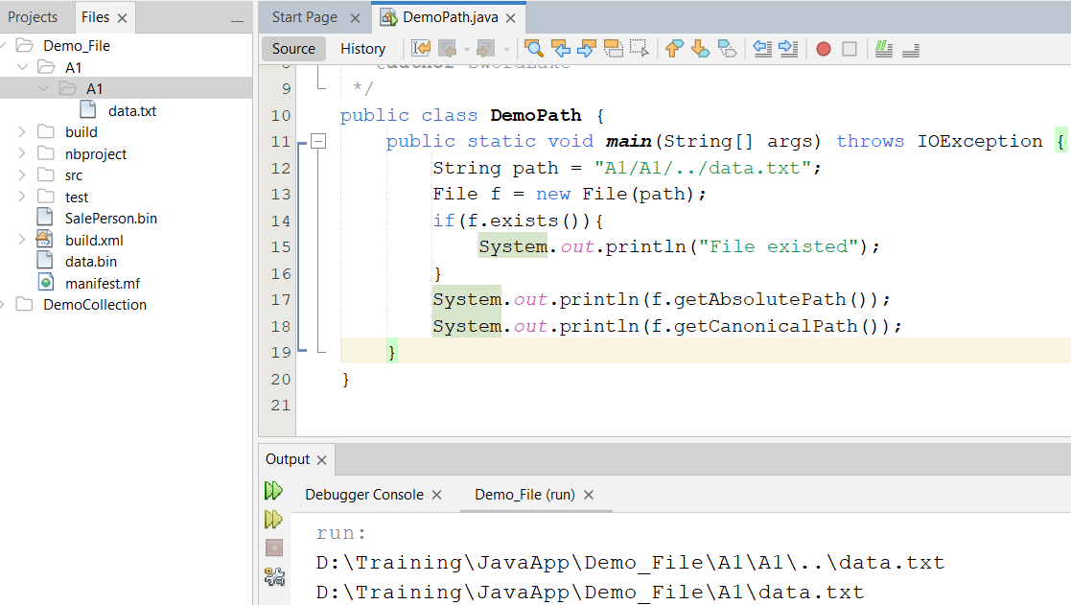
Demo

Slide 11

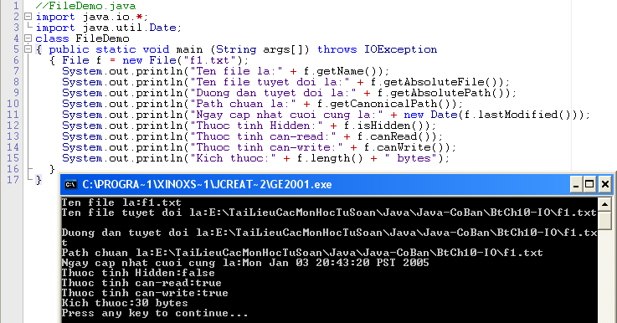
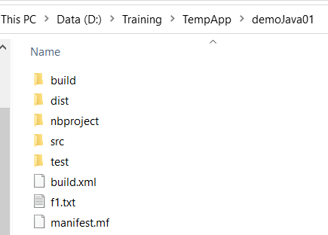
Accessing directories and files…
The java.io.File Class…
Get File Attributes Demo.
Hành vi lastModified() trả về 1 số long mô tả chênh lệnh mili giây kể từ January 1, 1970, 00:00:00 GMT. Thông qua 1 đối tượng Date giúp đổi chênh lệch mili giây này trở lại thành ngày giờ GMT

Slide 12
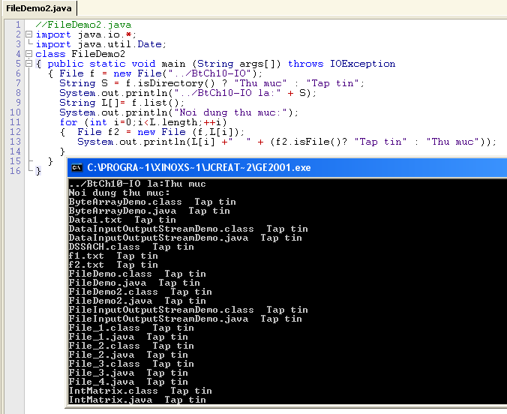
Accessing directories and files…
The java.io.File Class…
Accessing a folder Demo.
./ : current folder
../ : Father of current folder

Slide 13
4- Access Text Files
Character Streams:
Two ultimate abstract classes of character streams are Reader and Writer.
Reader: input character stream will read data from data source (device) to variables (UTF characters).
Writer: stream will write UTF characters to data source (device).

Slide 14
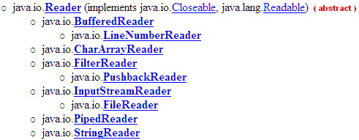
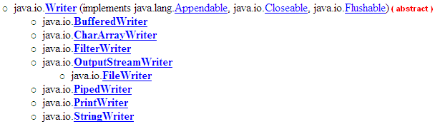
Access Text Files … Character Streams

Slide 15
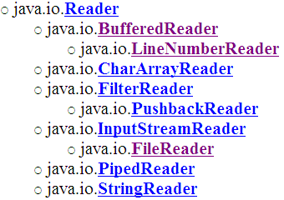

Access Text Files … Reading Data
File
2
read()
char c;
1
-1?
FileReader
TextFile
(filename)
readLine()
String S;
split
null?
BufferedReader
We must know data format in the file.
ClassA obj;
Type field1
Type field2
…………
LineNumberReader
getLineNumber()
int lineCurrentNo;

Slide 16
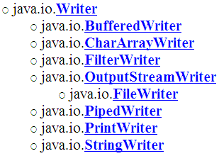
Access Text Files … Writing Data
File class
char c;
2
1
TextFile
(filename)
String S;
FileWriter class
write()
concatenate
print()
println()
ClassA obj;
Type field1
Type field2
…………
PrintWriter class
FileWriter(File file)
FileWriter(File file, boolean append)
FileWriter(FileDescriptor fdObj)
FileWriter(String name)
FileWriter(String name, boolean append)
We must design the data format in the file.

Slide 17
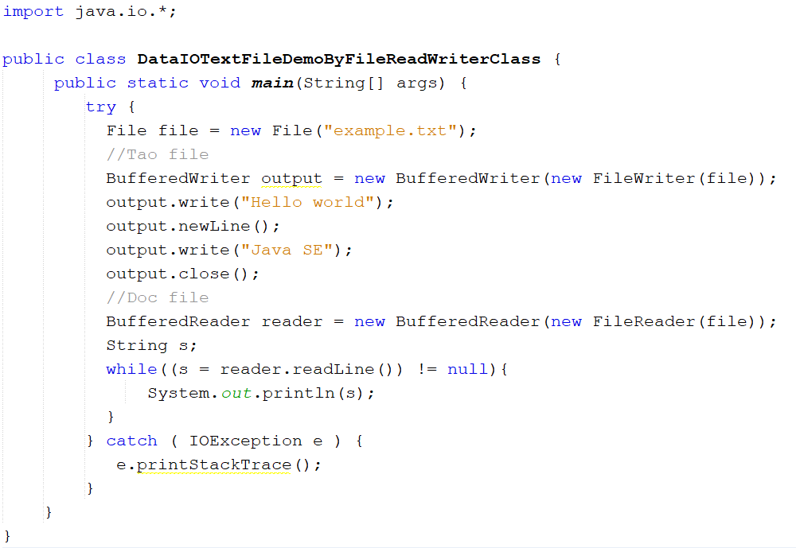
Demo 01

Slide 18
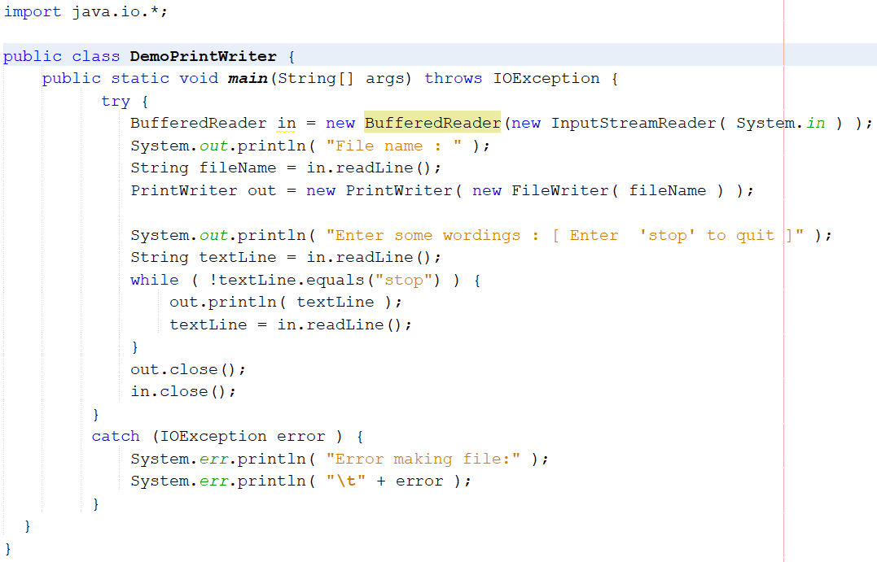
Demo 02

Slide 19
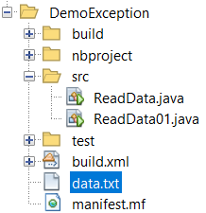
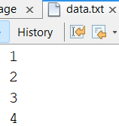
Demo 03

Slide 20
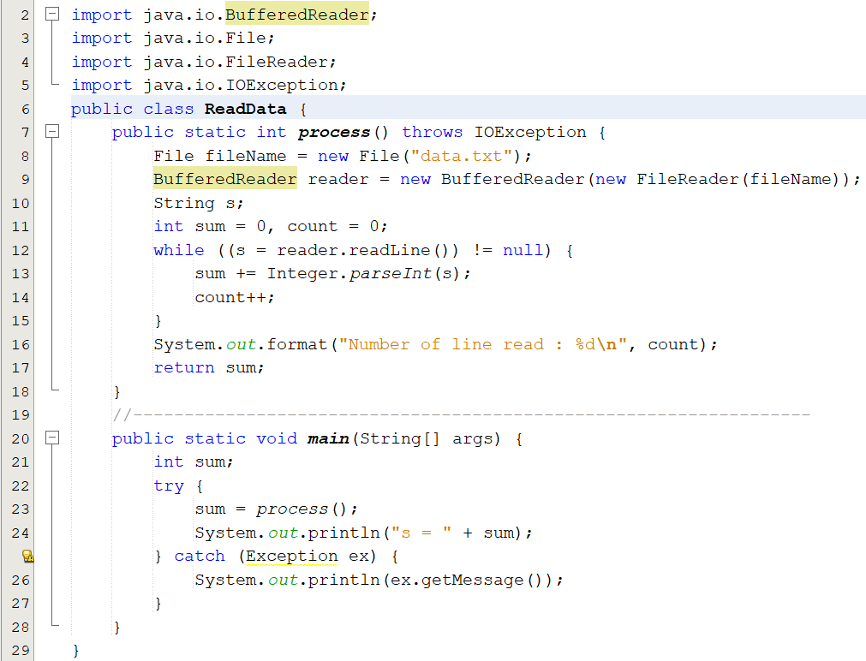
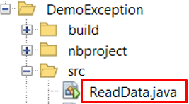
Demo 03

Slide 21
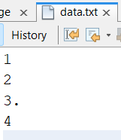
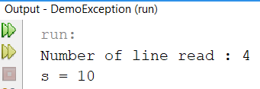

Demo 03

Slide 22
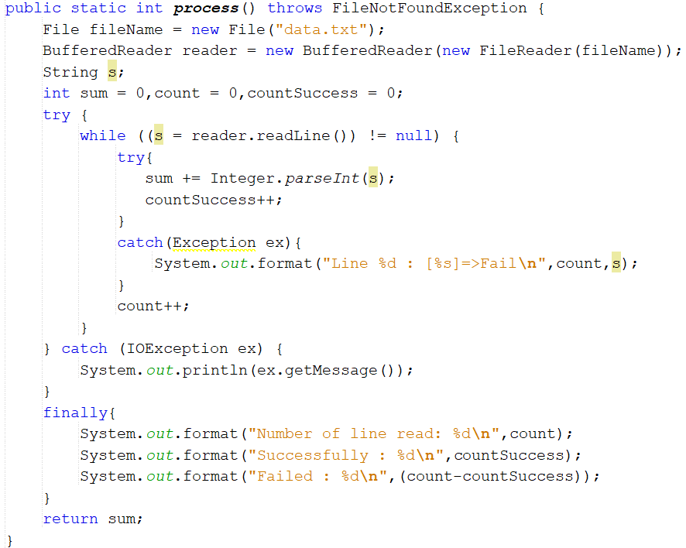
Demo 03-2

Slide 23
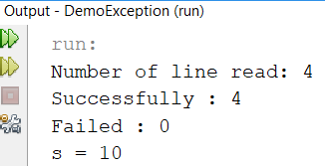
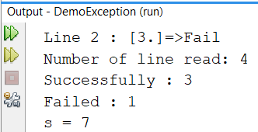
Demo 03-2

Slide 24
Access Text Files … Case study 1
Problem
Each employee details include: code, name, salary
The text file, named employees.txt contains some initial employee details in the following line-by-line format
code, name,salary
Write a Java program having a simple menu that allows users managing a list of employees. Functions are supported:
Adding new employee
Removing employee.
Promoting the salary of an employee.
Listing employee details.
Save the list to file
Quit

Slide 25
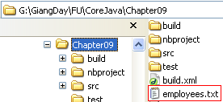
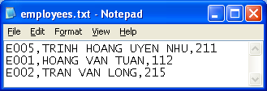
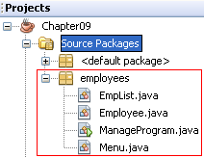
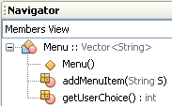
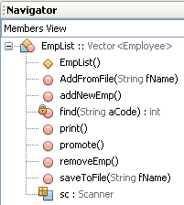
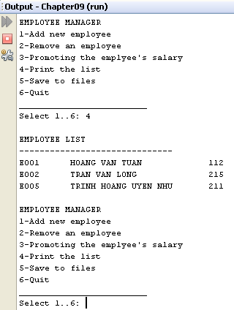
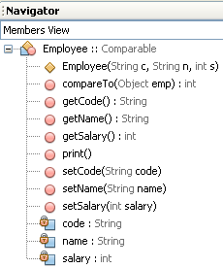

Access Text Files …: Case study 1- Design

Slide 26
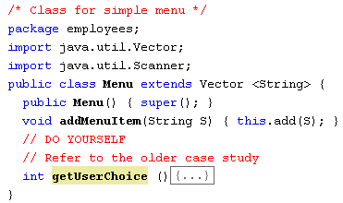
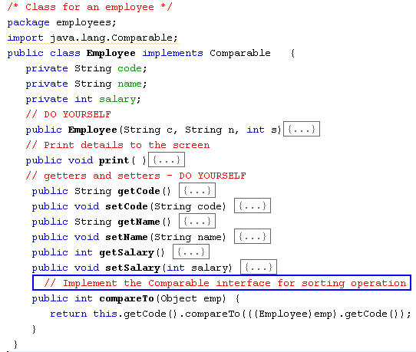
Access Text Files …: Case study 1- Implementations

Slide 27
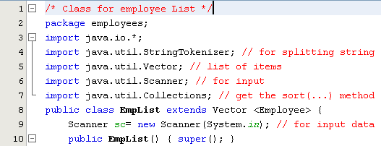
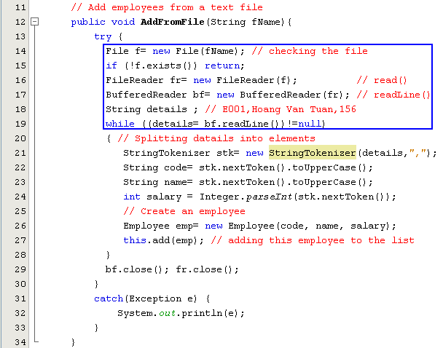
Access Text Files …: Case study 1- Implementations

Slide 28
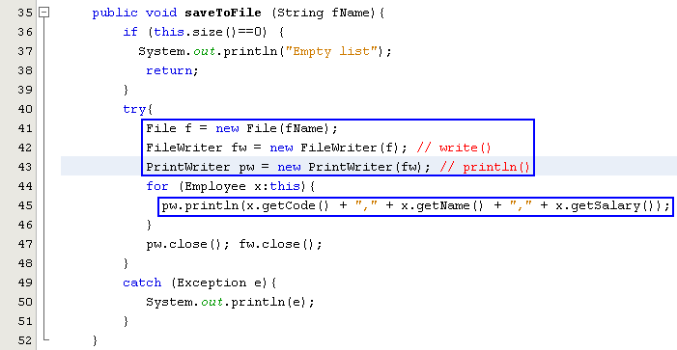
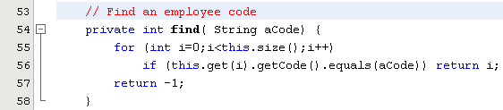
Access Text Files …: Case study 1- Implementations

Slide 29
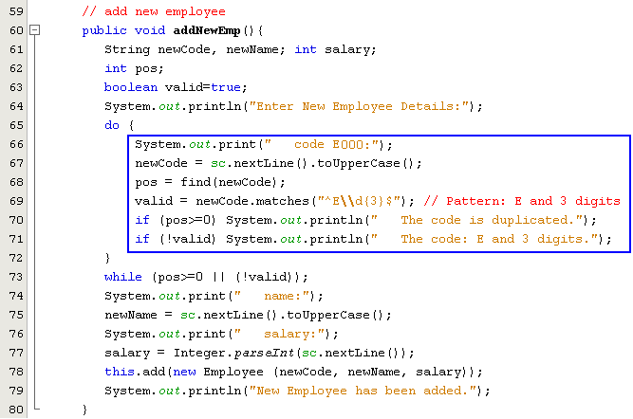
Access Text Files …: Case study 1- Implementations

Slide 30
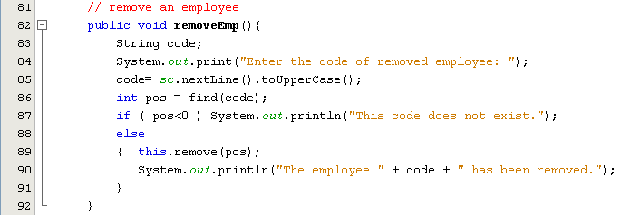
Access Text Files …: Case study 1- Implementations

Slide 31
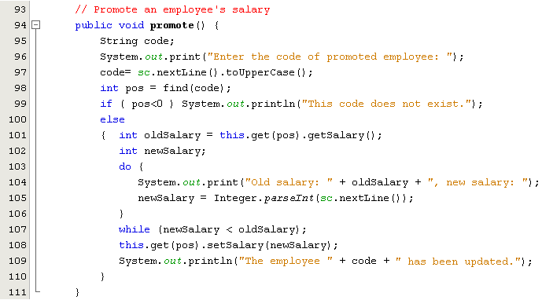
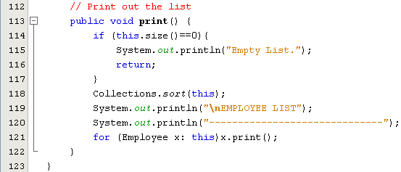
Access Text Files …: Case study 1- Implementations

Slide 32
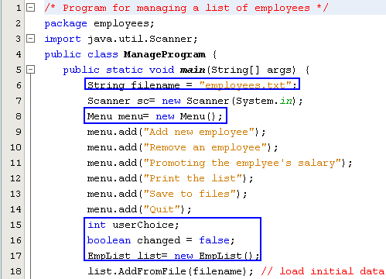
Access Text Files …: Case study 1- Implementations

Slide 33
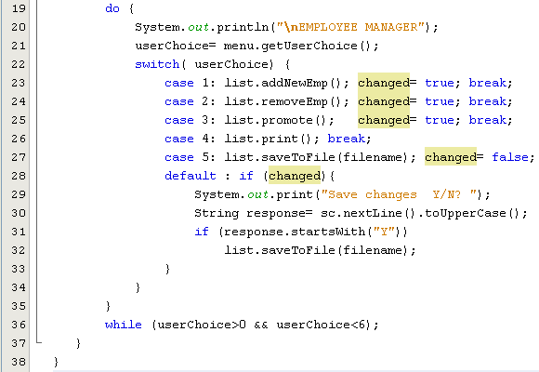
Access Text Files …: Case study 1- Implementations

Slide 34
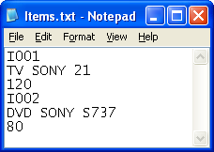
Access Text Files …: Case study 2.- Append File Demo.
Problem
Each item details include: code, name, price. The item’s code can not be duplicated.
An accountant can not be allowed to view all stored items ( in the text file, named items.txt) but he/she can add some new items to this file.
Data format in this file (line by line):
Line for the code of item
Line for the name of item
Line for the price of item
Write a Java program having a simple menu which allows users managing a item list through program’s functions:
Add new item
Update an item
Delete an item
Save items( Appending items to this file)

Slide 35
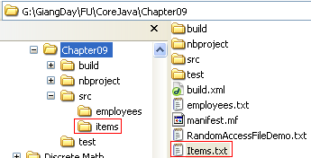
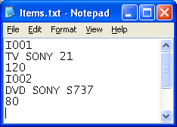
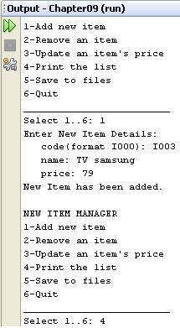
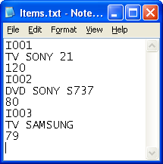
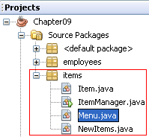
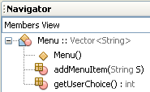
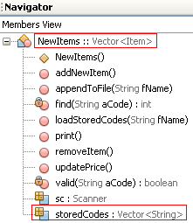
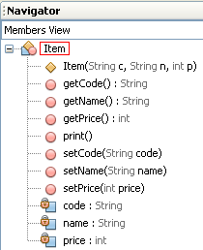


Access Text Files …: Case study 2.-Design

Slide 36



Access Text Files …: Case study 2- Implementations
Refer to the case study 1.
DO YOURSELF

Slide 37


Access Text Files …: Case study 4.- Implementations

Slide 38

Access Text Files …: Case study 2- Implementations

Slide 39

Access Text Files …: Case study 2- Implementations

Slide 40


Access Text Files …: Case study 2- Implementations

Slide 41


Access Text Files …: Case study 2- Implementations

Slide 42
Access Text Files …: Read UTF-8 File content
UTF8 content is stored in compressed format➔ a character will be stored in 1 to 3 bytes.
Before reading UTF, decompressing is needed.
String content=“”;
FileInputStream f = new FileInputStream(filename);
InputStreamReader isr = new InputStreamReader(f, "UTF8");
int ch;
while ((ch = isr.read()) > -1) content+=(char)ch;
For read bytes
For read a unicode character
Or
“UTF-8”
String content=“”, s;
FileInputStream f = new FileInputStream(filename);
InputStreamReader isr = new InputStreamReader(f, "UTF8");
BufferedReader br = new BufferedReader (isr);
while ( (s= br.readline())!=null) content += s + “\n”;
For read a unicode character or string.

Slide 43




Applying Text File

Slide 44

Applying Text File

Slide 45

Applying Text File

Slide 46

Applying Text File

Slide 47

Applying Text File

Slide 48

Applying File & Collection

Slide 49
5- Access binary files
Binary streams.
Low-level streams: reading/writing data byte-by-byte.
High-level stream: reading/writing general-format data (primitives – group of bytes that store typed-values)

Slide 50
Access binary files… The java.io.RandomAccessFile class
It is used to read or modify data in a file that is compatible with the stream, or reader, or writer model
It supports:
Get the file pointer
Get the length of the file
Seeking to any position within a file
Reading & writing single byte/groups of bytes, treated as higher-level data types
Close file.

Slide 51
Access binary files … java.io.RandomAccessFile class…
Constructors
RandomAccessFile(String file, String mode)
RandomAccessFile(File file, String mode)
Mode “r” to open the file for reading only
Mode “rw” to open for both reading and writing
Mode “rws” is same as rw and any changes to the file’s content or metadata (file attributes) take place immediately
Mode “rwd” is same as rw, and changes to the file content, but not its metadata, take place immediately. Its metadata are upadated only when the file is closed.

Slide 52



Access binary files … java.io.RandomAccessFile class…
A demo. for write data to a file then read data from the file
The try…catch statement must be used when accessing file – checked exception
WRITE
READ

Slide 53


Access binary files… Binary Streams

Slide 54


Access binary files… Low-Level Binary Stream Demo.1
These values can not be greater than 127 because only the lower bytes are written to the file.
Write data to file
We can not read these number in the file because of binary file. However, we can see characters.

Slide 55


Access binary files… Low-Level Binary Stream Demo.1…
Read data from the file then print them out.
Convert array of characters to string for printing them easier.
Read a byte: ‘5’
Read the blank
Read the blank
Read a number
Read filename stored at the end of the file

Slide 56

Access binary files… Low-Level Binary Stream Demo.2
This demo. Is the same as the previous one. But, all small number will be converted to digits then write them to the file
Write data to file
Now, we can see all the file content because they are characters

Slide 57


Access binary files… Low-Level Binary Stream Demo.2…
Read data from the file

Slide 58
Access binary files High-Level Binary Stream
More often than not bytes to be read or written constitute higher-level information (int, String, …)
The most common of high-level streams extend from the super classes FilterInputStream and FilterOutputStream.
Do not read/write from input/output devices such as files or sockets; rather, they read/write from other streams
DataInputStream/ DataOutputStream
Constructor argument: InputStream/ OutputStream
Common methods: readXXX, writeXXX
BufferedInputStream/ BufferedOutputStream: supports read/write in large blocks
….

Slide 59


Access binary files… High-Level Binary Streams

Slide 60


Access binary files… High-Level Binary Stream Demo.
DataOutputStream
(int, string,…)
A high-level file access includes some low-level access
( read an int value includes 4 times of read a byte)
FileOutputStream
(byte)
File

Slide 61



Access binary files… High-Level Binary Stream Demo. …

Slide 62

6- Access Object Files
2 Object streams :Object Input stream, Object Output stream
Serialization is a task which will concate all data of an object to a byte stream then it can be written to a datasource. Static and transient data can not be serialized.
De-serialization is a task which will read a byte stream from a datasourse , split the stream to fields then assign them to data fields of an object appropriately.
Transient fields are omitted when an object is serialized.

Slide 63
Serialization
The process of writing an object is called serialization.
Use java.io.ObjectOutputStream to serialize an object.
It is only an object’s data that is serialized, not its class definition.
When an object output stream serializes an object that contains references to other object, every referenced object is serialized along with the original object.
Not all data is written.
static fields are not
transient fields are also not serialized

Slide 64
De-serialization
De-serialization is to convert a serialized representation into a replica of the original object.
Use java.io.ObjectInputStream to deserialize an object.
When an object is serialized, it will probably be deserialized by a different JVM.
Any JVM that tries to deserialize an object must have access to that object’s class definition.

Slide 65
Access Object Files…: How to?
FileInputStream
No method is declared
FileOutputStream
class A implements java.io.Serializable
{ Type field1;
Type field2;
…………
}
ObjectInputStream f;
ObjectOutputStream
readObject()
writeObject()
null?
File
(filename)
File
(filename)
A obj;
We can read/write objects from/to file using a program only.

Slide 66


Demo-01

Slide 67

Demo 02

Slide 68



Demo-02(cont.)

Slide 69
Access Object Files…: Case study 3 - Object Streams Demo.
Problem
Book <title, price>
Write a Java program that allows user:
View books in the file books.dat
Append a book to the file
Read/ Write books as binary objects from/to the file.

Slide 70






Access Object Files…: Case Study 3 - Design
Java serielize data of an object from the bottom of the declaration to the beginning.

Slide 71


Access Object Files…: Case Study 3- Implementations
Refer to the case study 1, 2.
DO YOURSELF

Slide 72

Access Object Files…: Case Study 3– Implementations…

Slide 73

Access Object Files…: Case Study 3– Implementations…

Slide 74

Access Object Files…: Case Study 3– Implementations…

Slide 75

Access Object Files…: Case Study 5 – Implementations…

Slide 76


Lab Serialization

Slide 77
Summary
Text, UTF, and Unicode
Accessing metadata of directories/files (java.io.File)
Text Streams, Reader, and Writer
The java.io.RandomAccessFile Class
Binary file Input and Output (low and high-level)
Object Streams and Serializable

Slide 78

Review OOP

